Slide 1
Condition of Foregin Key
Notes:
1

Slide 3
Integrity Constraints:
Enrolled
Student
Sid | Cid | Fee
S1 | C1 | -
S1 | C2 | -
S2 | C1 | -
S3 | S2 | -
Sid | Sname | Login
S1 | A | @
S2 | A | @
S3 | B | @
S4 | C | @
S5 | B | @

Slide 5
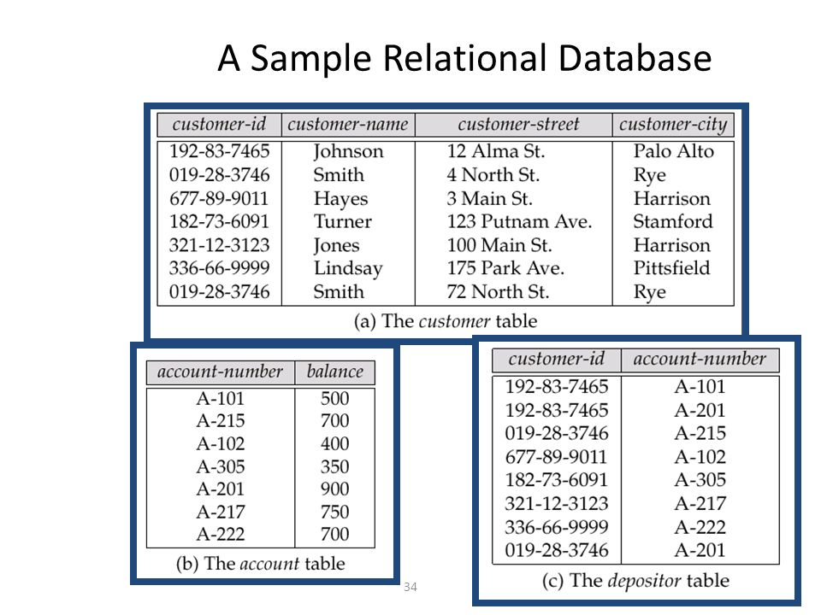

Slide 6
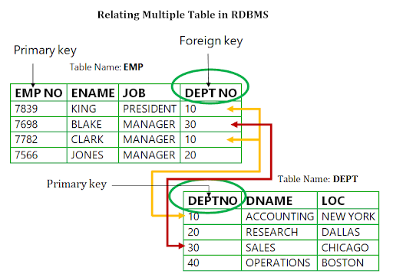

Slide 7
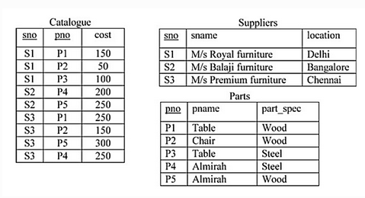

Slide 8
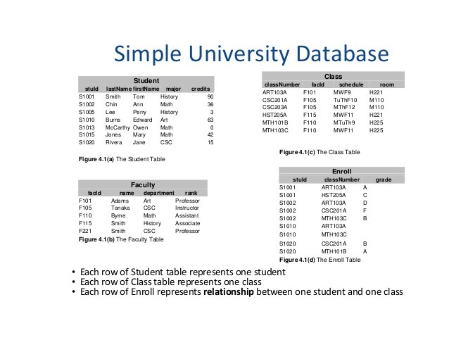

Slide 9
Create Student and enrolled Tables
CREATE TABLE `dbms_c`.`student1` ( `S_id` VARCHAR(5) NOT NULL, `S_name` VARCHAR(45) NULL, `Login` VARCHAR(45) NULL, PRIMARY KEY (`S_id`));
CREATE TABLE enrolled (
S_id varchar(5) NOT NULL,
C_id varchar(5) NOT NULL,
Fees int,
PRIMARY KEY (S_id, C_id),
FOREIGN KEY (S_id) REFERENCES student(S_id)
);

Slide 10
Insert data into student table
INSERT INTO `dbms_c`.`student` (`S_id`, `S_name`, `Login`) VALUES ('S1', 'A', '@');
INSERT INTO `dbms_c`.`student` (`S_id`, `S_name`, `Login`) VALUES ('S2', 'A', '@');
INSERT INTO `dbms_c`.`student` (`S_id`, `S_name`, `Login`) VALUES ('S3', 'B', '@');
INSERT INTO `dbms_c`.`student` (`S_id`, `S_name`, `Login`) VALUES ('S4', 'C', '@');
INSERT INTO `dbms_c`.`student` (`S_id`, `S_name`, `Login`) VALUES ('S5', 'B', '@');

Slide 11
Insert data into enrolled table
INSERT INTO `dbms_c`.`enrolled` (`S_id`, `C_id`, `Fees`) VALUES ('S1', 'C1', '40');
INSERT INTO `dbms_c`.`enrolled` (`S_id`, `C_id`, `Fees`) VALUES ('S1', 'C2', '40');

Slide 12
Referenced Relation:(PK)
Insertion:No violation
Deletion: (Many cases violation)
Updation:(Many Cases violation)

Slide 13
Referenced Relation:On delete no action
On delete no action (Default): not allowed to delete from referenced relation if referenced integrity violation occurs.
DELETE FROM `dbms_c`.`student` WHERE (`S_id` = 'S1');
Execute SQL Statement(Error)

Slide 14
Referenced Relation:On delete Cascade
On delete Cascade:
create a table
CREATE TABLE enrolled_cascade (
S_id varchar(5) NOT NULL,
C_id varchar(5) NOT NULL,
Fees int,
PRIMARY KEY (S_id, C_id),
FOREIGN KEY (S_id) REFERENCES student(S_id) on delete cascade
);

Slide 15
Referenced Relation:On delete Cascade
Insert data in enrolled_cascade table
INSERT INTO `dbms_c`.`enrolled_cascade` (`S_id`, `C_id`, `Fees`) VALUES ('S1', 'C1', '30');
INSERT INTO `dbms_c`.`enrolled_cascade` (`S_id`, `C_id`, `Fees`) VALUES ('S2', 'C2', '40');
INSERT INTO `dbms_c`.`enrolled_cascade` (`S_id`, `C_id`, `Fees`) VALUES ('S3', 'C3', '34');

Slide 16
Referenced Relation:On delete Cascade
Now delete S1 id from the student table
DELETE FROM `dbms_c`.`student` WHERE (`S_id` = 'S1');
from table enrolled_cascade, S1 row will also be deleted.

Slide 17
Referenced Relation:On delete set null
It specifies that the child data is set to NULL when the parent data is deleted. The child data is NOT deleted.
create a table
CREATE TABLE enrolled_cascade (
S_id varchar(5) NOT NULL,
C_id varchar(5) NOT NULL,
Fees int,
PRIMARY KEY (S_id, C_id),
FOREIGN KEY (S_id) REFERENCES student(S_id) on delete set null
);

Slide 18
Referenced Relation:Updation
On update no action: not allowed to delete from referenced relation if referenced integrity violation occurs.
On update Cascade:
On update set Null:

Slide 19
Referencing relation constraints:
Insertion:many case violation
Deletion : No violation
Updation: Many cases violation
Here no corresponding action like on delete no action

Slide 20
Example:
A is Primary Key
C is foreign Key referencing Primary key.
C is FK reference A with on delete cascade
A | B | C
2 | 3 | 4
3 | 5 | 4
4 | 9 | 3
5 | 7 | 2
9 | 8 | 5
6 | 8 | 4

